Slide 1
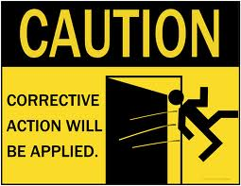

CAR Review
Sept 27, 2013
Mark Lavine, Mel Fehrenbacher

Slide 2

CAR 133911831-OFI/Obs
Generally good level of attention for OFI
Provided training and revised datasheet- good.
Overall very good handling of Observation.
Proper record-keeping helps maintain integrity

